Slide 1

World Electricity
A Data Analytics Project

Slide 2
Contents
01
02
03
04
Introduction and Objective
Understanding and Phases
Interesting Insights
Conclusion and Future Scope

Slide 3
Introduction

Slide 4

Objective
A comprehensive look at the current state of electricity generation, consumption and distribution across the globe.
Examine the trends in electricity consumption by different sectors and regions, and assess the progress being made towards the revolution.
We hope that this presentation aims to provide a clear and accurate understanding of the state of world electricity

Slide 5
Understanding the Problem
Define
Understand
Explore
Setting the goals and objectives of the project,
and guide the data analysis.
Identify any missing or irrelevant data, and plan how to acquire or clean the data if necessary.
Visualization to explore and gain an understanding of the patterns, and relationships.

Slide 6
Phases
Data Collection
Preparation for Manipulation
P1
P2
P3
P4
Defining Problem and Objectives
Manipulation and Analysis

Slide 7
Struggles and Solutions
Struggled with : Data Cleaning and Preparation, Quality and Accuracy
P1
Developed a data cleaning plan that outlines the steps needed to clean and prepare the data, including which data needs to be cleaned, how it will be cleaned, and who will be responsible for each step.
Test the cleaned data by performing a few sample analyses to make sure that the data is ready for further analysis.

Slide 8
Struggles and Solutions
Struggled with : Limited and Inconsistent Data
P2
Data Sampling
Selected a smaller subset of the data to work with
E.g. There was not any data before 1990’s but the required data was in the 2000’s time frame
We performed analysis on that data instead which presents the larger part of dataset

Slide 9
Struggles and Solutions
Struggled with : Lengthy Queries, Columns, Data Modeling
P3
Broke down complex queries into smaller, more manageable pieces
Selected only the columns that are needed for the analysis.
Had a hard time finding common elements across different tables.

Slide 10
Struggles and Solutions
Struggled with : Manipulation, Visualization, Integrations
P4
Validated Data using formulaes to ensure completeness, consistency, and accuracy is present
Determining the formatting of data for visualization
Summarized data for finding Integrations

Slide 11
Analysis

Slide 12
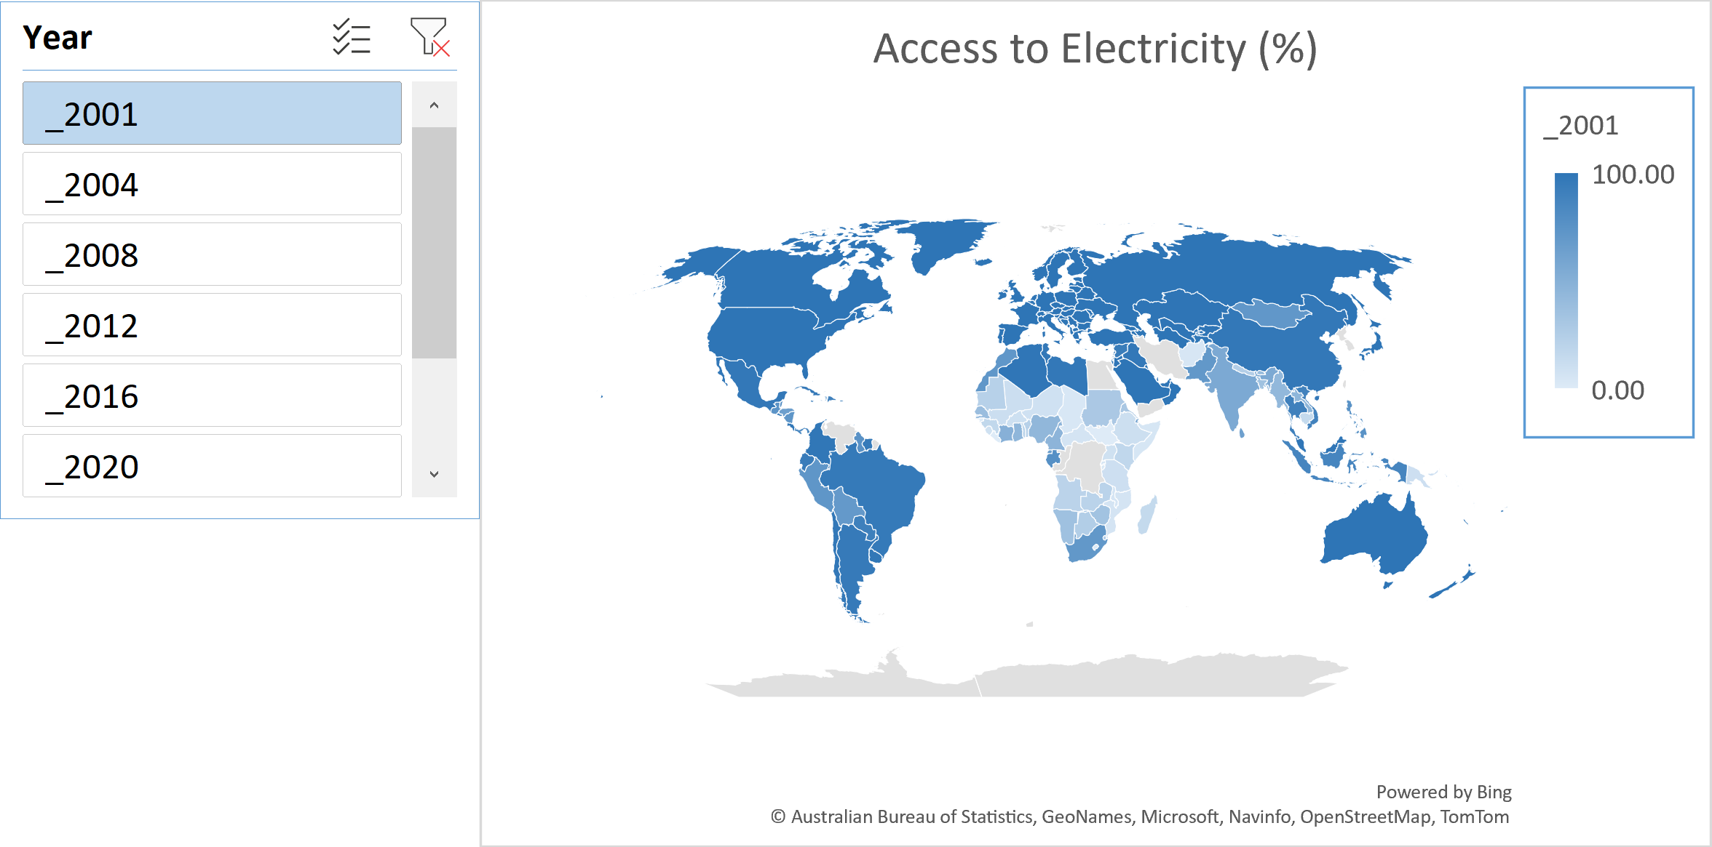
Post 2000
%

Slide 13
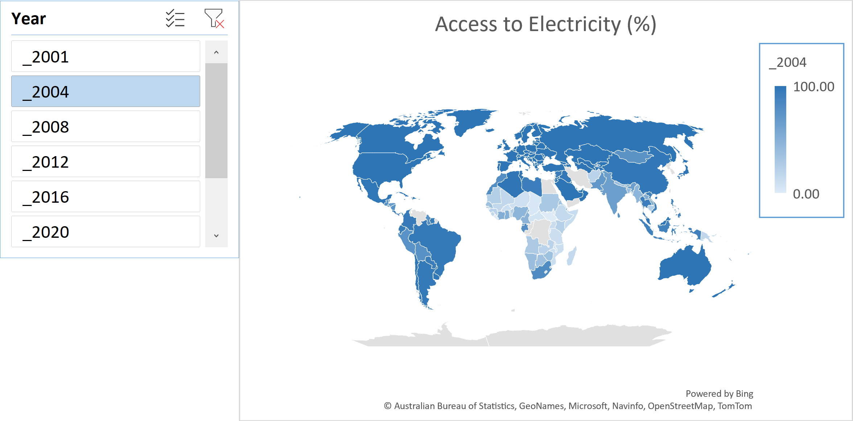
Post 2000
%

Slide 14
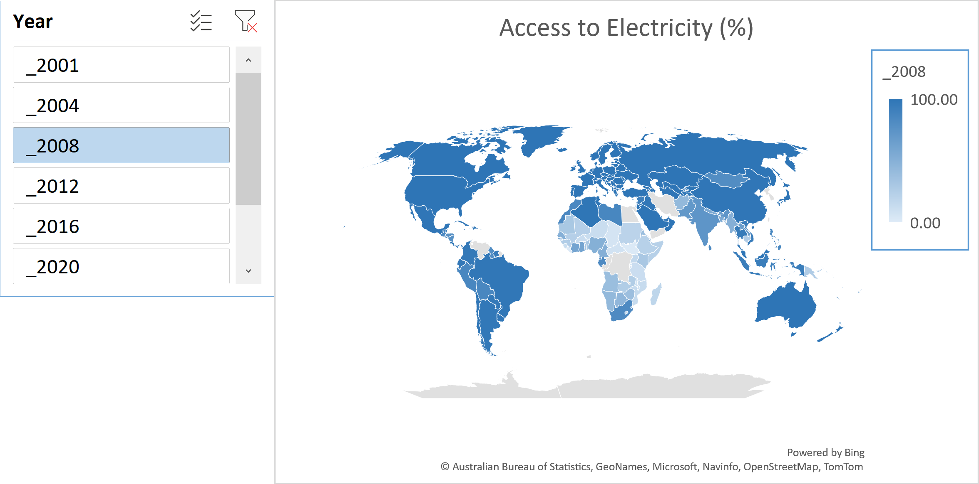
Post 2000
%

Slide 15
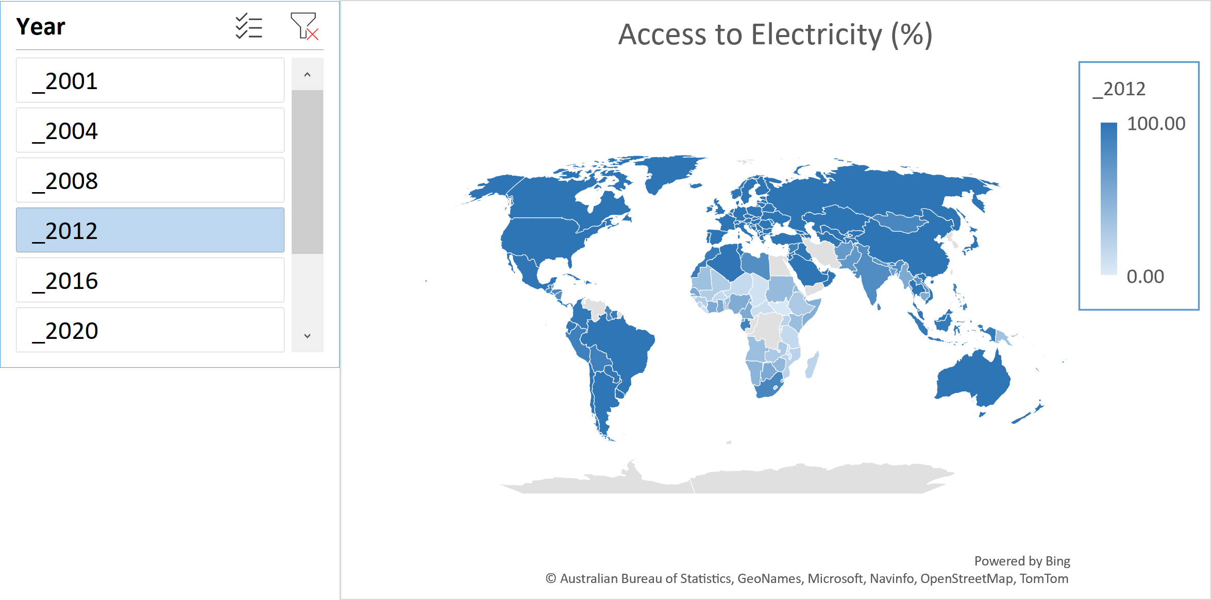
Post 2000
%

Slide 16

Post 2000
%

Slide 17
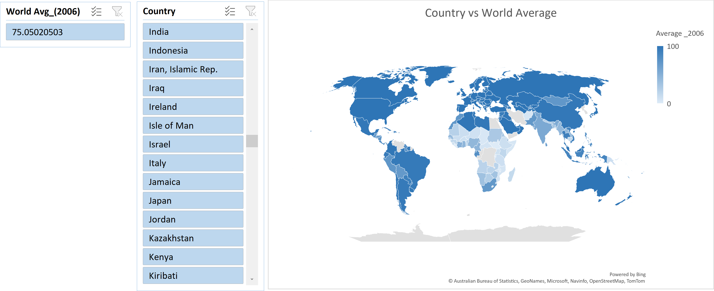
World Average
%

Slide 18
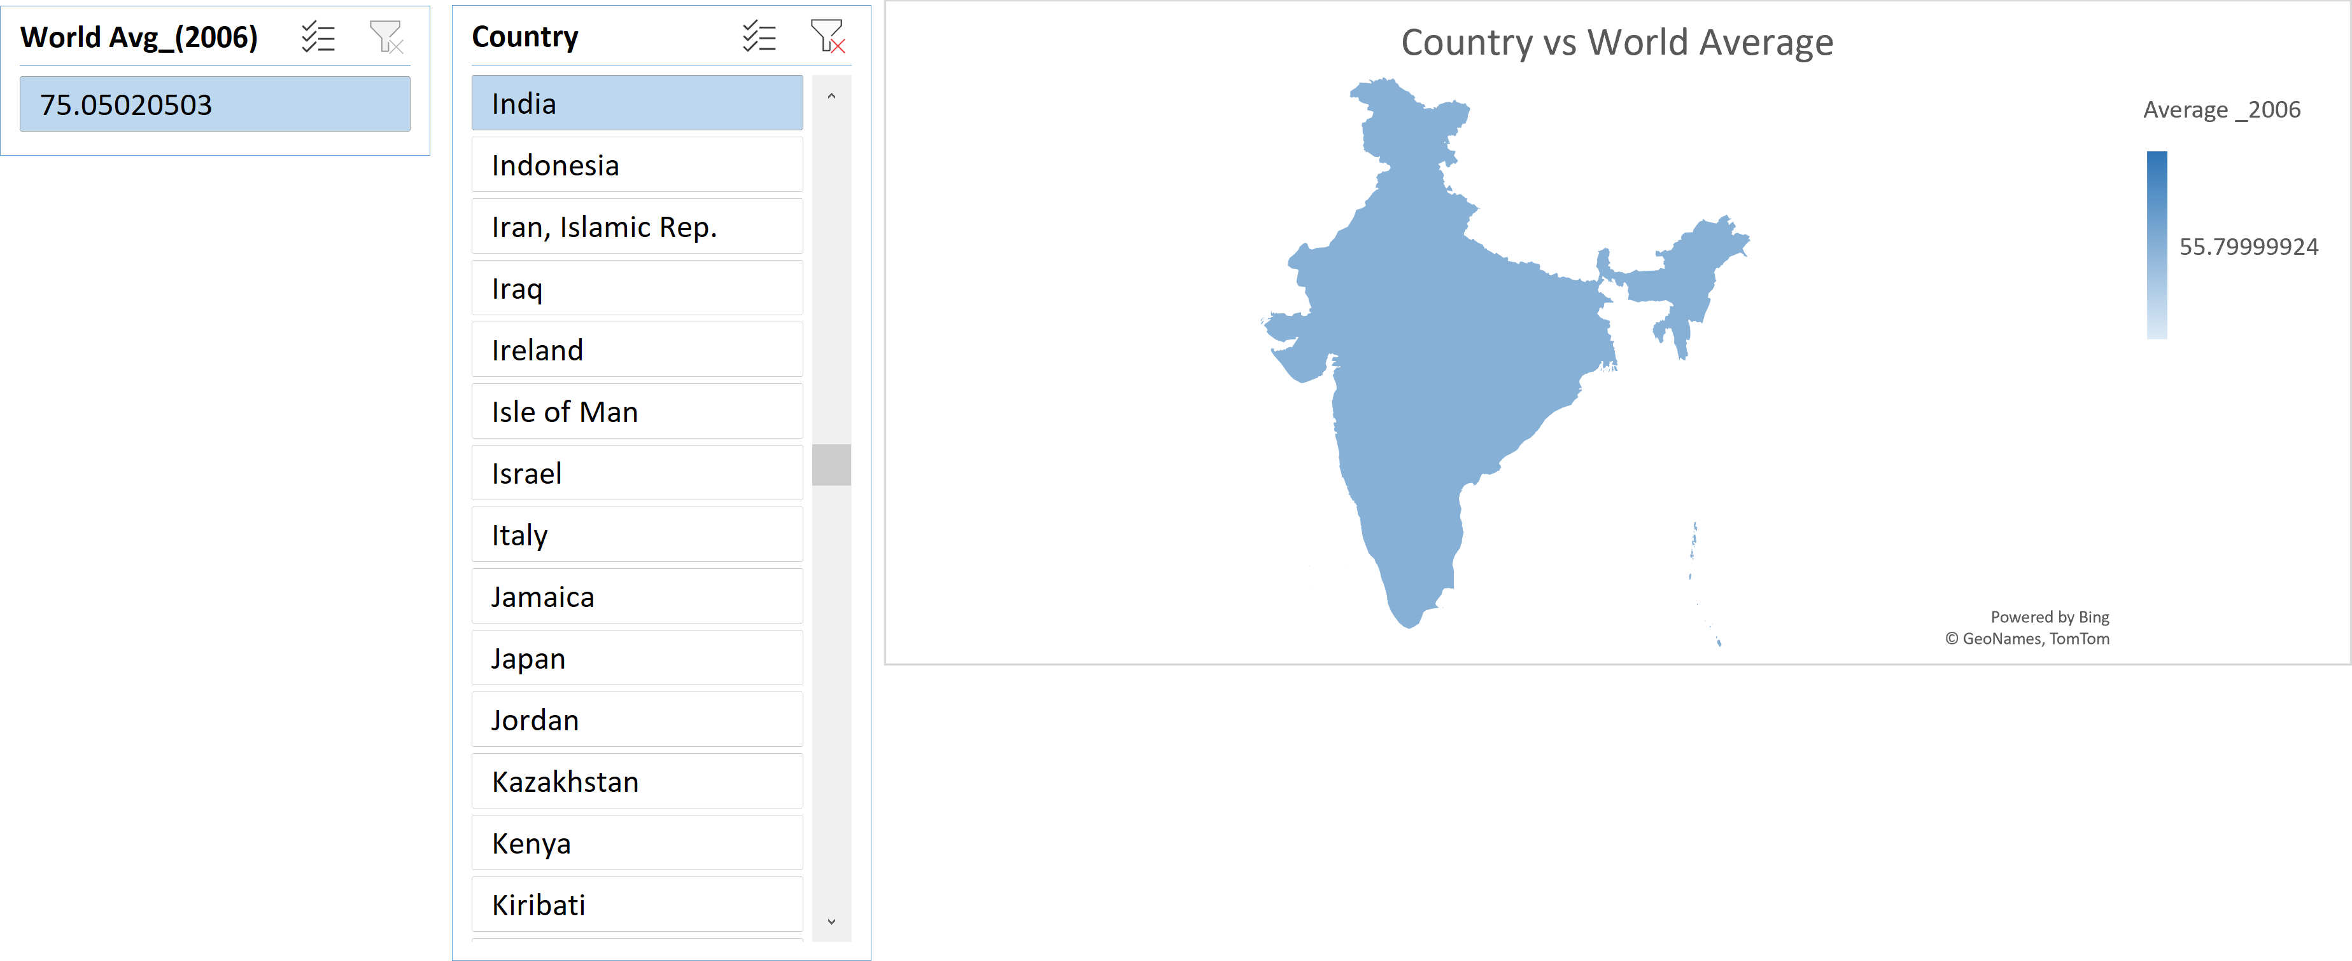
World Average
(%)
%

Slide 19
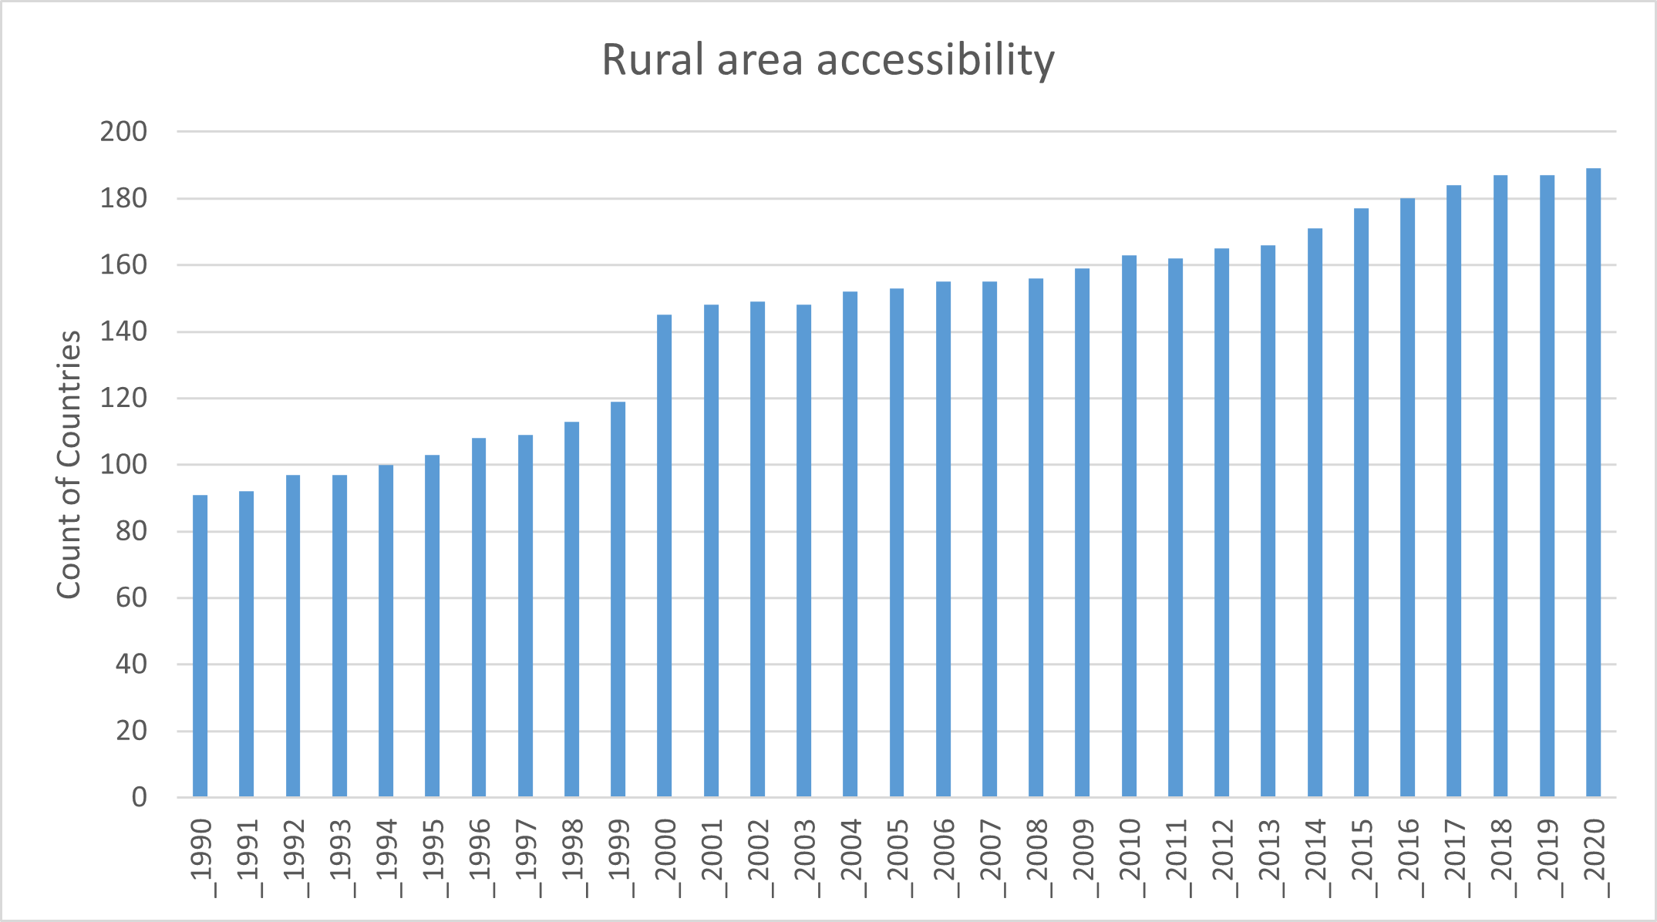
Greater than 75%

Slide 20
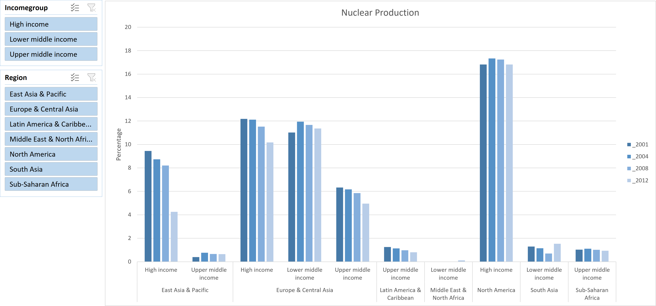
Region wise comparison

Slide 21
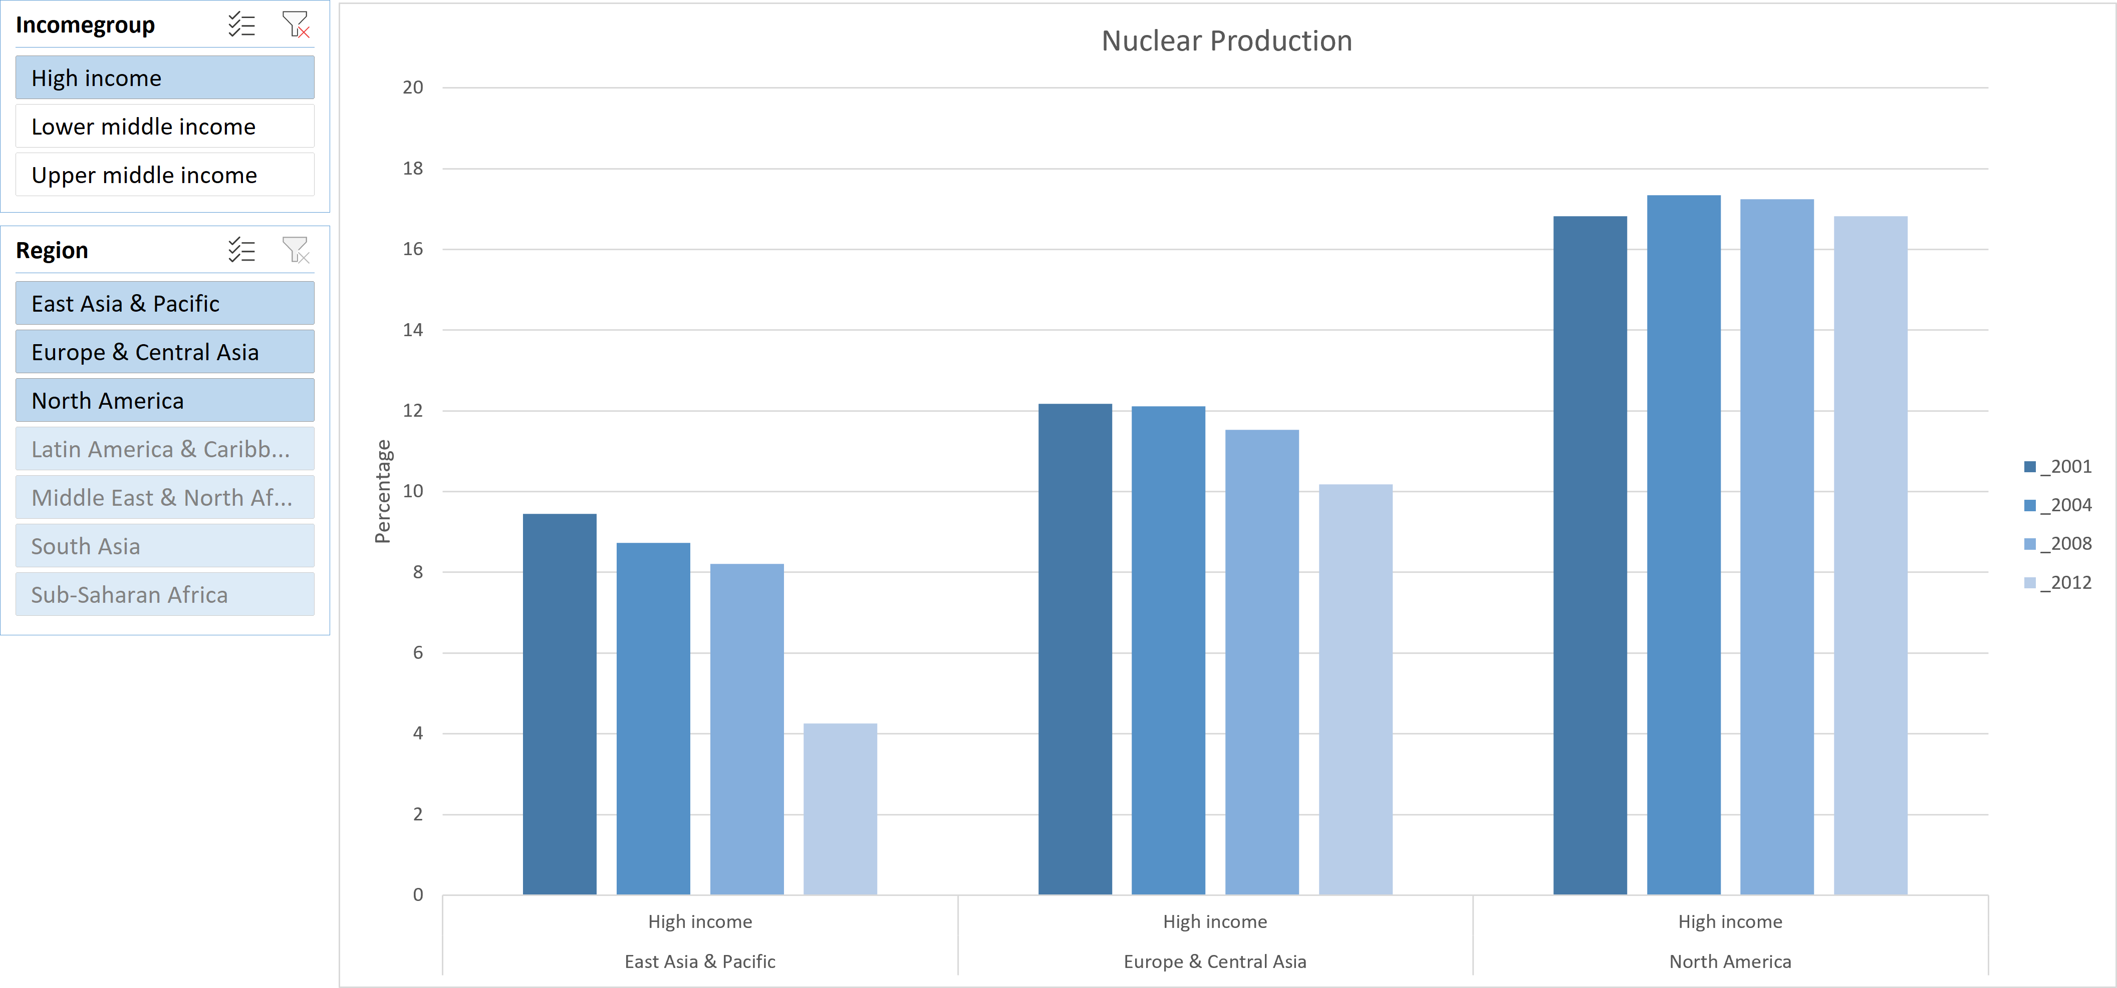
Region wise comparison

Slide 22
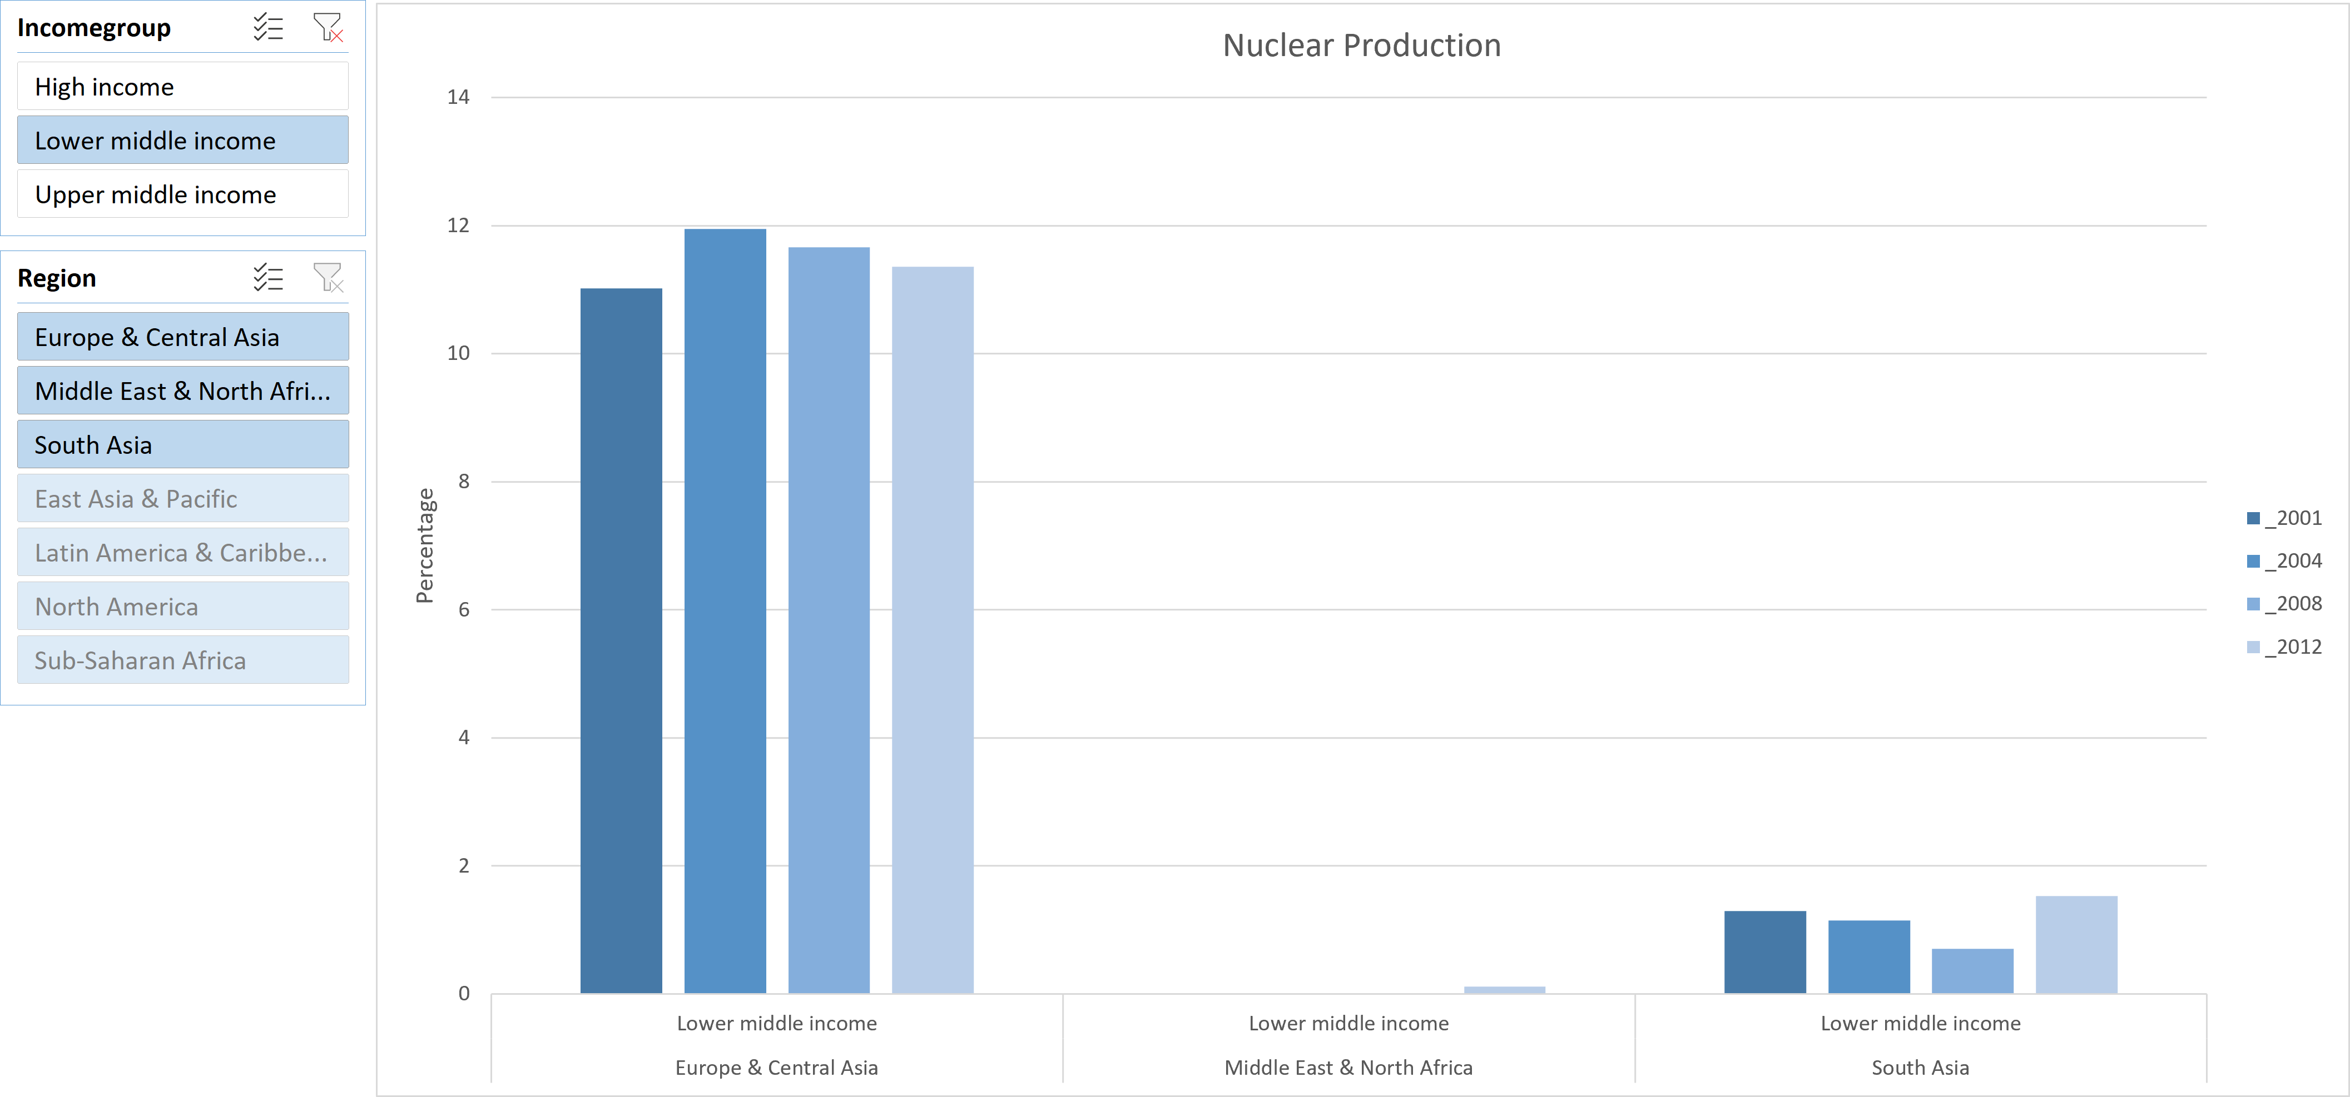
Region wise comparison

Slide 23
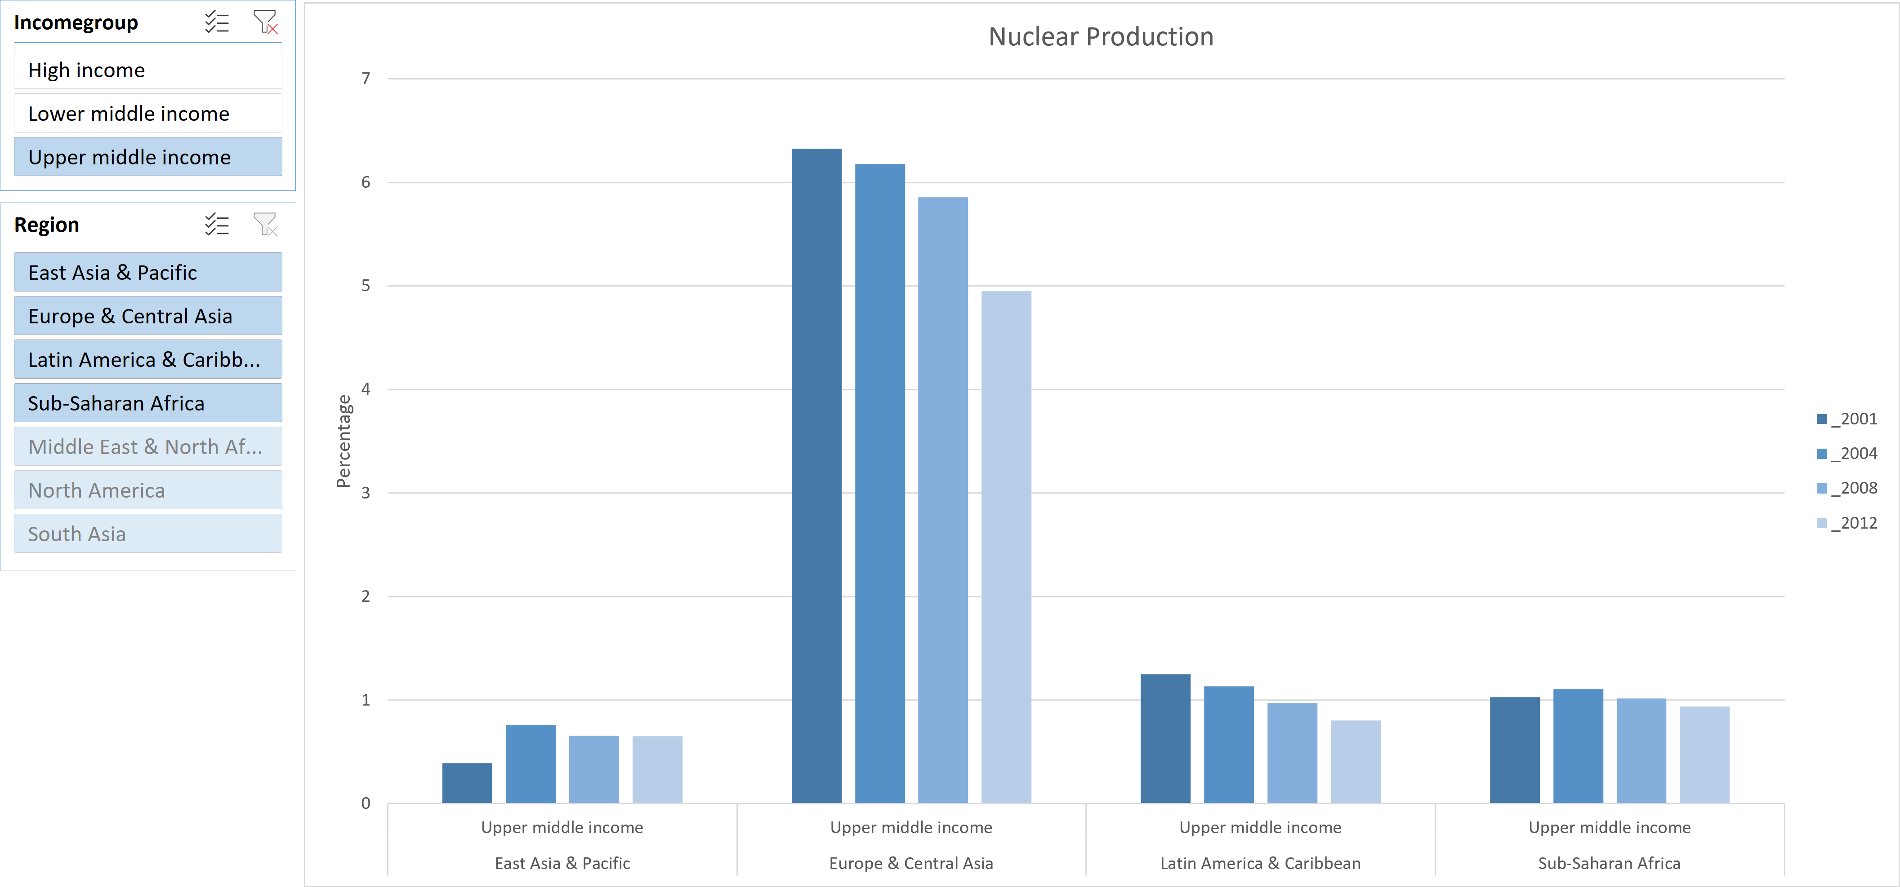
Region wise comparison

Slide 24
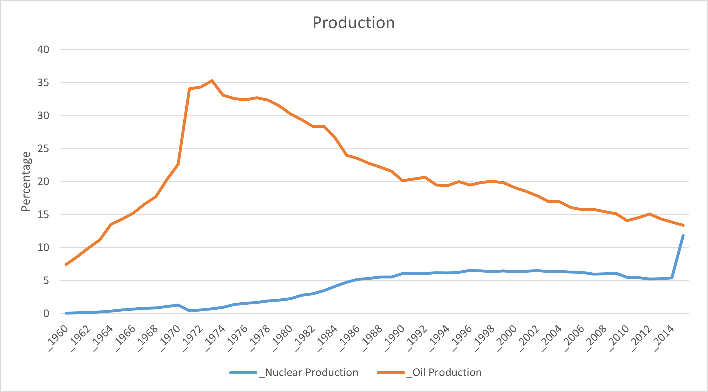
Time comparison

Slide 25
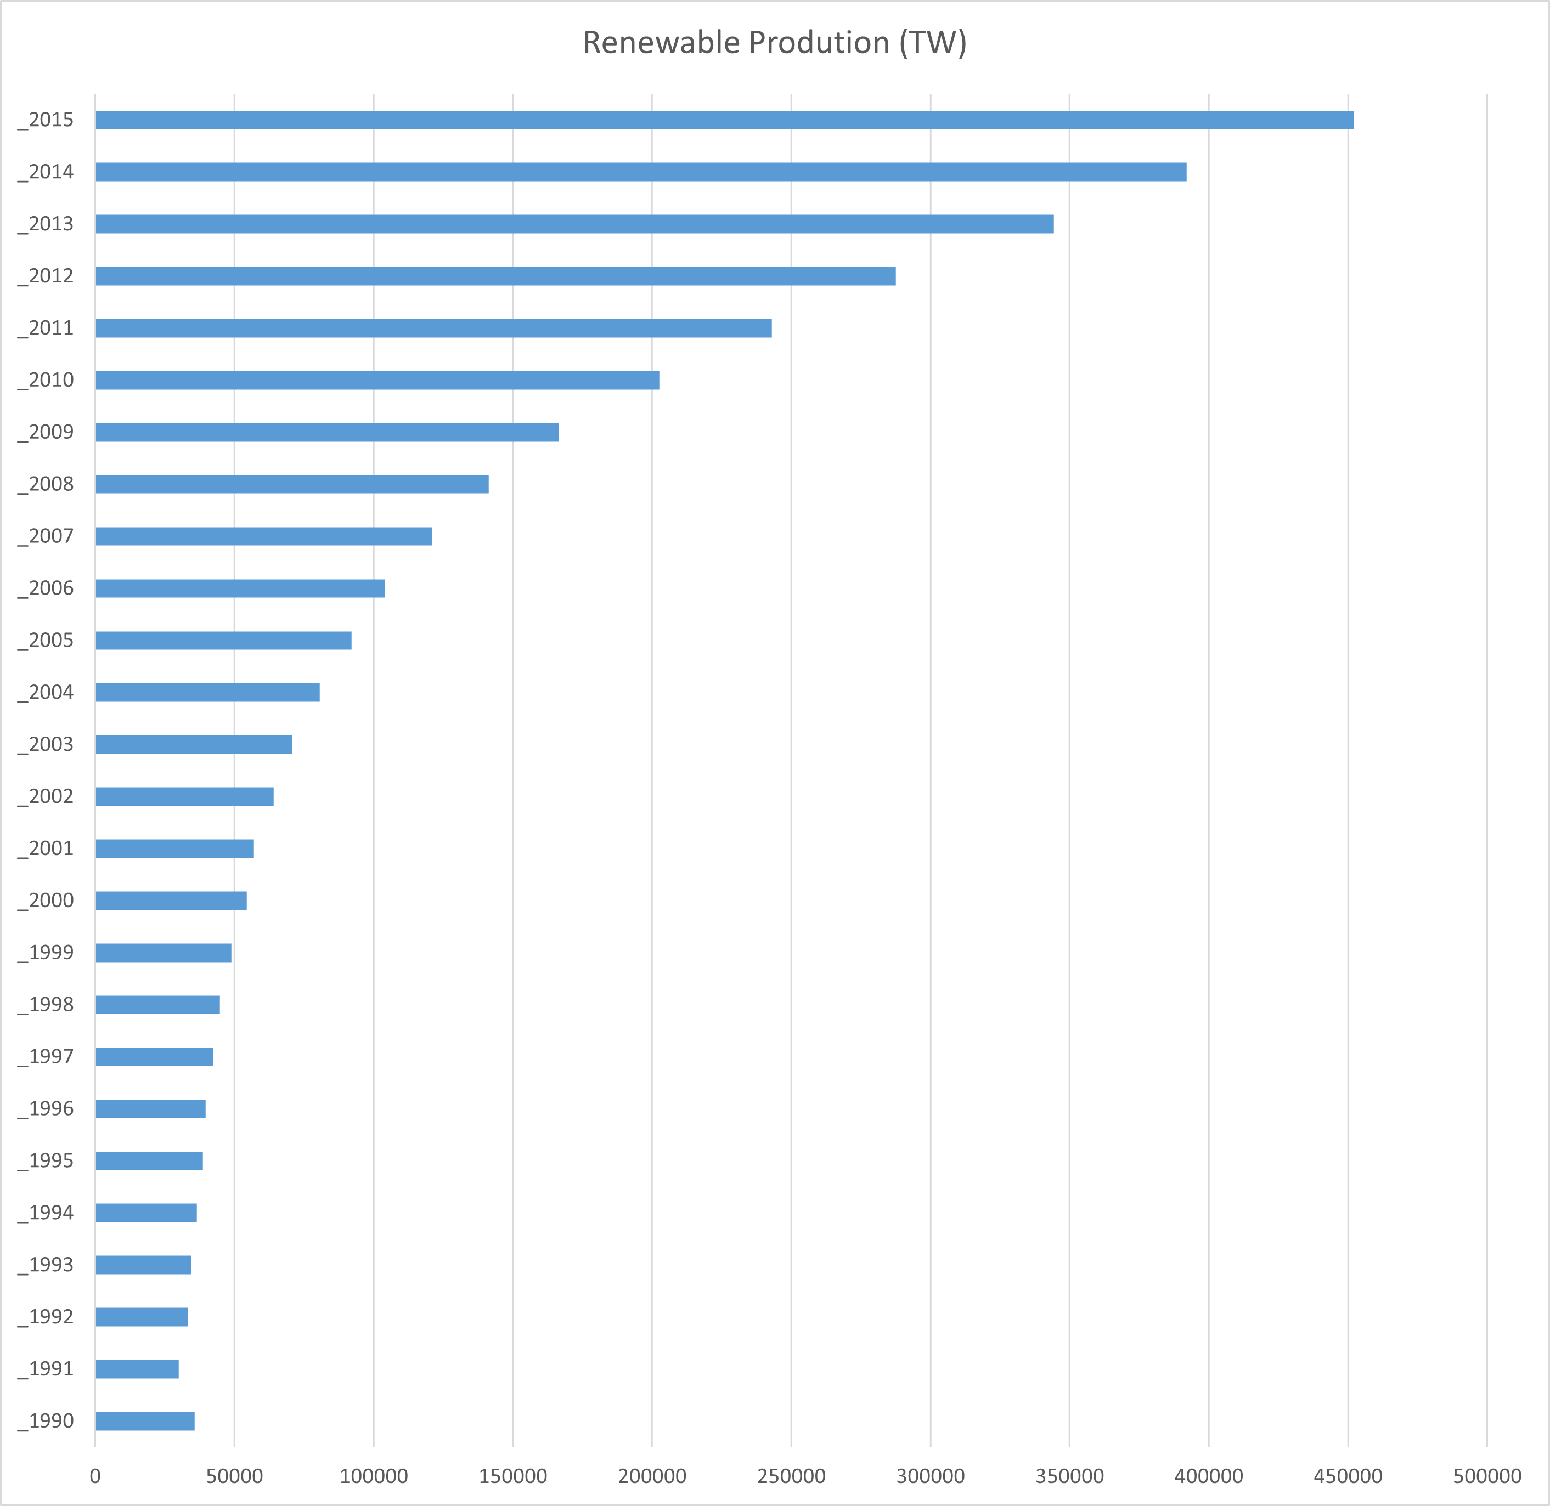
Renewable Production

Slide 26
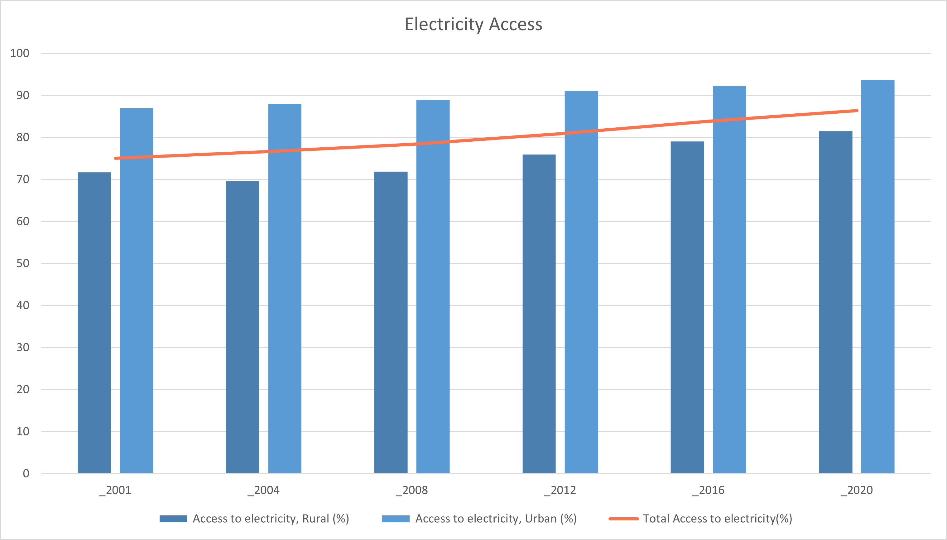
Urban vs Rural

Slide 27
Observations
Climate
Economic Growth
Temperature extremes can also drive electricity usage
Businesses and households consume more energy
Population Growth
Energy Intensive Industries
A growing population also leads to increased demand for electricity
Manufacturing and mining, require large amounts of electricity

Slide 28
Dashboard

Slide 30
Conclusion

Slide 31
Last 20 Years
Renewable Sources
Increase in Consumption

Slide 32
Thanks!
Do you have any questions?
Please keep this slide for attribution

